Slide 1
CSS
MCNDHS
Ms. Eng

Slide 2
AIM: COLOR THEORY (HEXADECIMAL)
Do now:
NOTEBOOKS (50%)
CLASSROOM ASSIGNMENT (50%)
Go to color-hex.com
Daily Grade:
On-time/attendance/not leaving the classroom: 25%
Cellphones: 25%
Notes:25%
Classwork/Homework: 25%

Slide 3
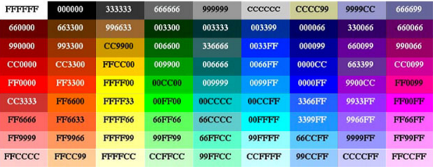
LAST NIGHT:
Question: How do you come up with these numbers and letters!?!?!

Slide 4
BACKGROUND:
A computer can only produce 24-bits of color on a monitor with the current technology.
hexadecimal: #_ _ _ _ _ _ <-6 units
Permutation (non repeating combinations): ₂₄P₆ =16,777,216 colors

Slide 5
BASIC CONCEPT:
Numbers:
00-99
00-Deepest primary color
99-Brighter(Lighter) primary color
Anything higher than 99:
A-F

Slide 6

RGB
all colors follow this structure:

Slide 7
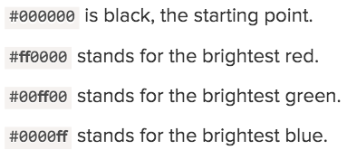
EXAMPLES:

Slide 8
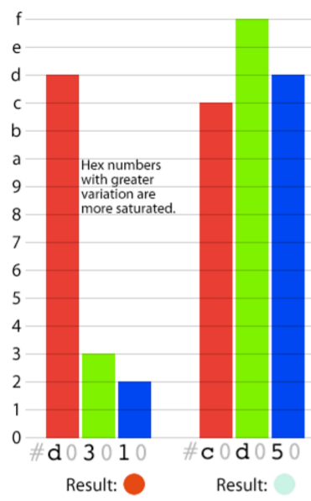
EXAMPLE 2:
conceptual question:
Why is the color on the right
“Lighter” than the color on the left?
Bonus question:
How do I get the color black? (not dark grey,blue,etc..) but the deepest black?

Slide 9
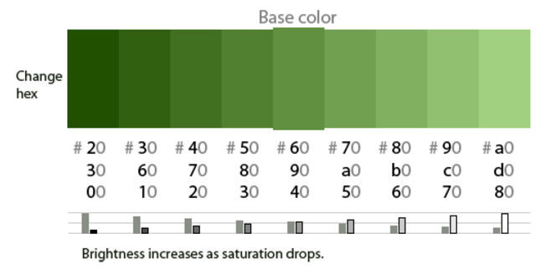
HOW DO YOU WORK WITH COLOR?
Step 1: PICK A BASE COLOR
lighter: GO UP numbers
Darker: GO DOWN numbers

